Slide 1
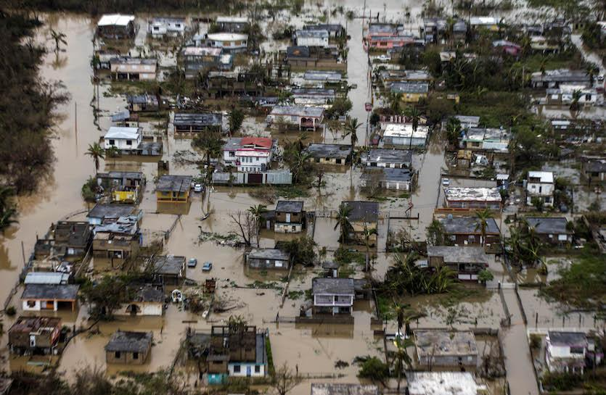
BACKGROUND
The Coastal-Urban Environmental Research Group develop an experimental Weather Research and Forecasting (WRF) Model for Puerto Rico
This WRF models have some errors. Therefore, the aim is to build a machine learning model that uses real precipitation data to correct the model results
Next Generation Weather Radar (NEXRAD) that detect precipitation and wind with a temporal resolution of approximately 5 minutes
Flooded area during Hurricane Maria¹
¹ https://www.washingtonpost.com/news/post-nation/wp/2017/09/22/at-least-6-dead-in-puerto-rico-due-to-hurricane-maria-officials-say/
Notes:
since September of 2020
Our research interest started when Hurricane María made landfall in Puerto Rico (PR) on September 20th of 2017 Water intakes on rivers were damaged due to extensive river meandering and sedimentation
Tool to predict streamflow and flooding
- WRF is a next-generation mesoscale numerical weather prediction system designed for both atmospheric research and operational forecasting applications.
- It is predicting the next 72 hrs at 1 km resolution. Variables such as Wind Speed, Wind direction, precipitation, and others
- This WRF models have some errors, so we want to use some real precipitation data to build a machine lea

Slide 2
IMPROVING PRECIPITATION FORECAST OVER THE PUERTO RICO BY USING NEXRAD DATA
Said A. Mejia-Manrique, Doctoral Student
Dr. Reza Khanbilvardi
The City College Of New York
June 30th, 2022
Notes:
Add universities, day

Slide 3
RESEARCH QUESTIONS
Is the model precipitation (WRF) accurate in comparison to the radar for selected months of 2021?
Is the hourly average precipitation and hourly precipitation volume the same for both?
Can a machine learning model be able to correct the precipitation output from WRF?

Slide 4
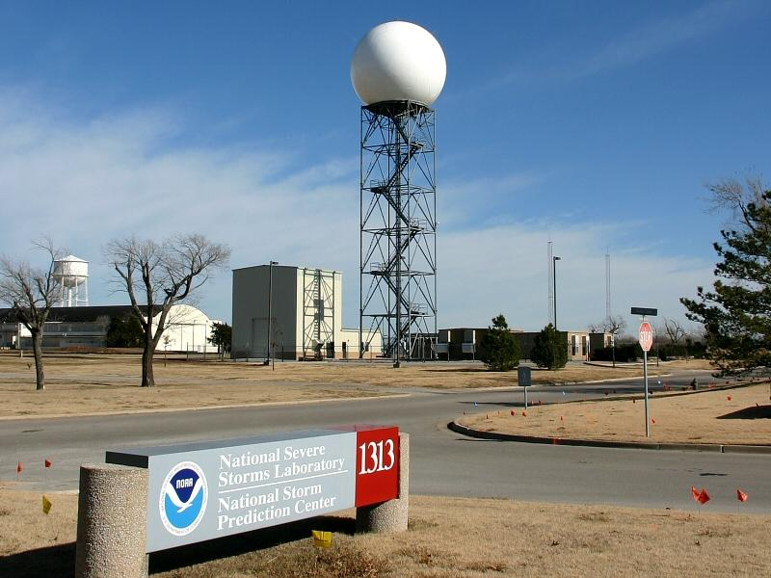
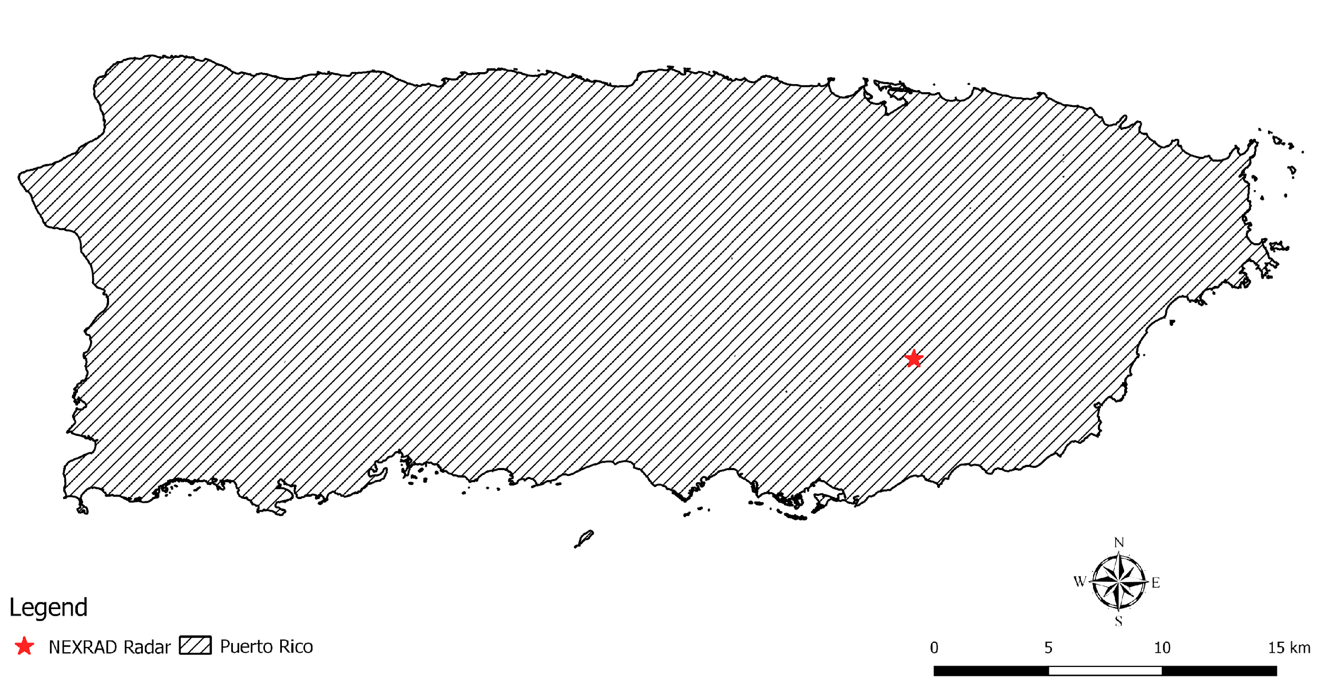
STUDY AREA

Slide 5
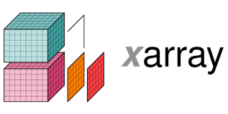
COMPUTER SKILLS
Python
Some Python
Packages:

Slide 6
RESEARCH OUTCOMES
Inform about the accuracy of the experimental CUERG-WRF model
Create a machine learning model that improves the WRF precipitation results
Develop some research skills such as:
Working with spatial and temporal gridded data
Data analysis
Visualization (maps and time series data)
Understanding of machine learning model

Slide 7
THANK YOU!!

